Slide 1






Manage operational risk
D2.TTO.CL4.11
Notes:
Trainer introduces himself/herself and welcomes the class.

Slide 2
Manage operational risk
This unit is comprised of 5 elements:
Undertake initial operational risk management procedures
Prepare risk management strategies
Communicate risk management strategies
Implement risk management strategies
Manage on-going risk exposure
Notes:
Trainer advises students that the unit comprises five elements, as listed on the slide explaining:
Each element has a number of performance criteria which will be identified throughout the class and explained in detail
Students can obtain more information from their Trainee Manual
The course presents advice and information but where the workplace requirements differ to what is presented, the workplace practices and standards must be observed.

Slide 3
Assessment
Assessment for this unit may include:
Oral questions
Written questions
Work projects
Practical activities
3rd party report
Observation checklist
Notes:
Trainer advises students that assessment for this unit may take several forms all of which are aimed at verifying they have achieved competency for the unit as required.
Trainer outlines to students the methods of assessment that will be applied to them for this unit.

Slide 4
Element 1: Undertake initial operational risk management procedures
Performance criteria for this element are:
1.1 Establish the context for operational risk
1.2 Identify operational risk
1.3 Assess operational risk
1.4 Identify operational risk control procedures
Notes:
Trainer outlines for students the Performance criteria for this Element, as listed on the slide.

Slide 5
1.1 Establishing the context for operational risk
Lan and Jo
Notes:
Go to page 9 of Trainee manual and read the example in the introduction.
Discuss the situation Lan and Jo are dealing with.
How many of you have experienced similar situations?
How has Po ‘s action transformed the situation?
How can we each become more like Po?

Slide 6

1.1 Establishing the context for operational risk
What is risk?
“The effect of uncertainty on objectives.”
International Organisation for Standardisation (ISO)
What is your definition of risk?
Notes:
Explain the ISO definition of risk to the group.
Get them to provide their own definitions of risk with particular emphasis on how it relates to their own work areas.
This is a simpler definition:
“A risk is the potential (or possibility) for a hazard to cause injury or illness in the workplace.”

Slide 7

1.1 Establishing the context for operational risk
Risk Management can be simplified into these 4 questions:
What untoward things could happen?
What would be the impact?
What can we do about it?
How do we tell everyone involved?
Notes:
The trainer can go through each of these questions with the group and ask them to relate these questions back to their workplace.

Slide 8

1.1 Establishing the context for operational risk
The four levels of risk:
Strategic level
Organisational level
Operational level
Task level
Notes:
Explain the four levels of risk:
Strategic – relates to actions taken at senior management level such as decisions to open a new hotel, start a new tour etc.
Organisational – which relate to the management structures, systems and processes that the organisation adopts to achieve its strategic goals.
Operational – which is linked to breakdown in systems within an organisation e.g. fraud, IT system failure, power outages.
Task risks – result from an individuals work tasks e.g. a team member forgetting to fulfil an F&B order so the hotel gets a poor reputation.
Get the group to provide an example of each within the hospitality industry.

Slide 9

1.1 Establishing the context for operational risk
Understanding the context of risk:
What is the organisation’s background?
What environment does it operate in?
What risk management activities will be undertaken?
What is the appropriate structure in which to manage this risk?
Notes:
Ask the group to break down these steps involved in understanding the context of risk as a group activity.

Slide 10

1.1 Establishing the context for operational risk
The external context of risk: PESTL
Political
Economic
Social
Technological
Legal
Notes:
Explain how a PESTL analysis can be used to establish external factors which may impact upon risk within the organisation. These can be looked at in a local, regional and international level.
Every organisation operates in an external environment which impacts greatly on its ability to achieve objectives.
Imagine a travel business with key operations in a region in Africa which becomes politically unstable. There are sizable risks associated with conducting business in this sort of environment.

Slide 11


1.1 Establishing the context for operational risk
The internal context of risk needs to be considered in terms of the risks associated with its:
Culture
Structure
Processes
Objectives
Notes:
The trainer explains the internal context of risk.
The internal workings of the organisation also need to be considered in terms of the risks associated with its culture, structure, processes and how it sets out to achieve its objectives. This involves understanding areas such as the resources and knowledge available to the organisation, how information is used, policies and systems used, standards adhered to and governance issues and perceptions of internal stakeholders.
Get the class to break up into groups and consider the External and Internal risk context of the organisations they work in.

Slide 12

1.1 Establishing the context for operational risk
A number of factors can impact on the operational environment and may have risks:
Weather
Customer numbers
Time of day
Seasonality
Type of activity or tour
Experience and age of customers
Ability and physical condition of customers
Equipment being used and location
Notes:
Ask the group how each of these may impact. This can be done as a question to the group and they discuss or they are broken into groups where they must present their answers.
Refer to page 10/11 of Trainee Manual for more information.

Slide 13

1.1 Establishing the context for operational risk
What are some events that could lead to risk?:
Personal health and injury
Product malfunction or failure, including systems and equipment
Damage to property and equipment, including customer property
Industrial dispute
Professional incompetence
Natural disasters
Security failure
Financial loss
Political events
Terrorism
Notes:
Go through the list with the group. Refer to page 11 of Trainee Manual for an explanation of each.
Has anyone experienced any of these?
Is there anything we could add to this list?

Slide 14

1.1 Establishing the context for operational risk
Compliance requirements:
Government Legislation
Industry regulations
Industry codes of practice
Company standards
ISO Certification
Notes:
Explain how the different compliance requirements can vary in different jurisdictions, but that increasingly the hospitality industry must adhere to similar standards such as hygiene etc every where in the world.
Using a whiteboard work up a list of all the regulations and rules the group is aware of and which are being followed in their own organisations. Do this for the hospitality and tourism/travel industries.

Slide 15

1.1 Establishing the context for operational risk
What stakeholders may be at risk?
Notes:
Trainer to ask the group: What stakeholders may be at risk?

Slide 16

1.1 Establishing the context for operational risk
Activity 1 - Far East Travel
What are the risks this business faces?
How can we explain them to staff?
Notes:
Activity 1 is in the Work Project section for this element on page 24 of the Trainee Manual.
It is recommended this is completed during class as a group activity.

Slide 17

1.2 Identify Operational Risk
Four root causes of risk:
People - How do the actions of people working in the business/organisation contribute to creating potential risks?
Process - What processes are currently being employed and what kinds of risks might be present in these processes?
Technology - The use of technology will represent many advantages for the organisation but it may also come with the potential for significant risk
Environment - The operating environment of the organisation needs to be carefully scrutinised to identify potential risk
Notes:
Trainer to go through each and explain the root causes of risk.
Get the group to provide an example of each.

Slide 18
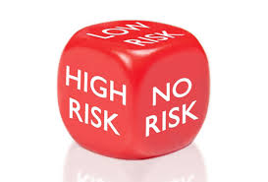
1.2 Identify Operational Risk
Identifying risk:
Where is the risk within the organisation?
When is the risk most likely to be present?
How is the risk manifested?
Why is the risk present?
What effects does the risk have?
Notes:
Trainer to take the group through the where, when, how, why and what approach with respect to examples from the hospitality and tourism/travel industries.
Refer to page 13 of Trainee Manual.

Slide 19

1.2 Identify Operational Risk
Identifying techniques:
Analysing incidents
Looking at historical data
Using SWOT analyses
Audits and inspections
Surveys and questionnaires
Reviewing legislation
Running risk identification workshops
Collecting best practice statistics
Notes:
Trainer to take the group through the techniques above. Refer to page 14 of the Trainee Manual.
Has anyone used any of these techniques in the workplace?
Group work: Divide into groups and pick out one technique (per group) and workshop with the group how it could be used in their own industry to identify risk.

Slide 20
1.2 Identify Operational Risk
Activity 2 Consider your own organisation
Identify and describe some risks
Notes:
Activity 2 is in the Work Project section for this element on page 24 of the Trainee Manual.
It is recommended this is completed during class as a group or individual activity.

Slide 21

1.3 Assess Operational Risk
Once risk has been identified, its nature needs to be assessed. What is the likelihood of risk?
Almost certain – denotes 80% probability
Likely – denotes >50% probability
Possible - denotes a >20% probability
Unlikely - denotes a >10% probability
Rare - denotes a 1% probability
Notes:
Likelihood can be expressed via the following Category rankings which classify risks into categories.
Go through the likelihood levels on page 15 of Trainee Manual.

Slide 22

1.3 Assess Operational Risk
What are the consequences of risk?
Death or permanent disability
Very serious injury or long term illness requiring specialist treatment or hospitalisation
Medical attention and several days of work
Minor injury requiring first aid but no time off work
Insignificant so no treatment required
Notes:
Trainer to discuss the consequences level with the group.

Slide 23
1.3 Assess Operational Risk
The Risk Equation
Risk = Consequence + Likelihood
Notes:
Talk with the group about the risk equation and how it can assist us to determine what action should be taken with regard to risks.

Slide 24
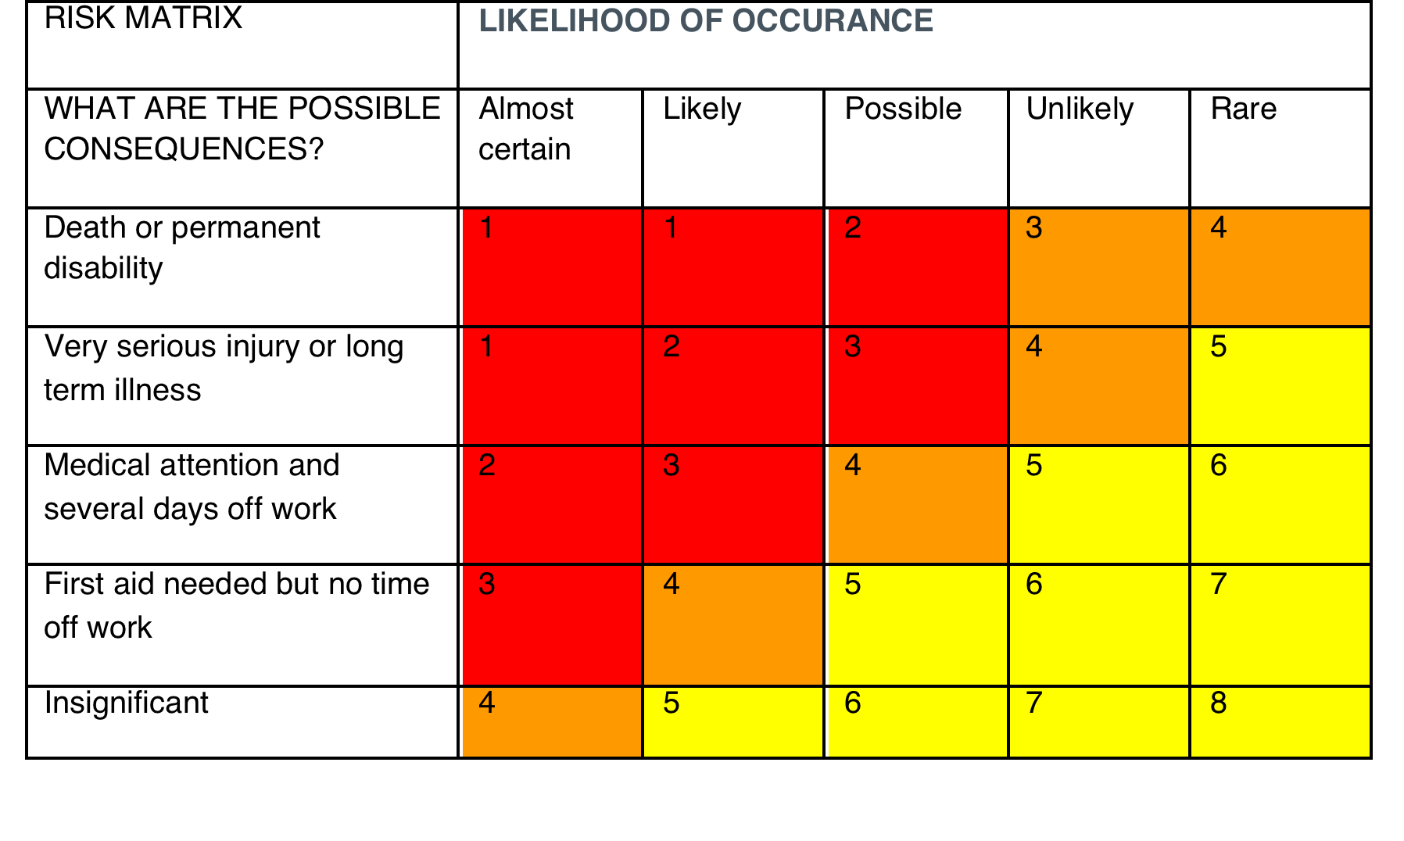
1.3 Assess Operational Risk
Action
If rated 1, 2 or 3 (red – high risk) you must consider alternatives to doing the action. Controls will need to be in place to ensure safety
If rated 4 (orange – medium risk) additional controls may be needed to undertake the task safely
If rated 5, 6, 7 or 8 (yellow – low risk) it is okay to undertake the tasks safely with the existing controls in place
Notes:
Trainer to show participants the risk matrix table and explain to them the relationship between likelihood and consequences.
By using this table you can prioritise the risks which are most likely to require action on your part and allocate resources where required. This information can then be used to assess the exposure of the business to damage or claims arising from the such risks eventuating.

Slide 25

1.3 Assess Operational Risk
Risk exposure:
Legal
Material
Financial
Should the risk be addressed?
Notes:
Trainer to explain to the group the three main exposure areas a business faces with regards to risk.
Legal - could risk events if realised lead to legal liabilities, either through the business being non compliant with legislation/regulation and facing fines, or via legal proceedings being initiated against it as a result of a stakeholder suffering loss which could be traced back to a risk the business should have provisioned for. Legal also implies a reputational loss if the business is seen to be negligent in managing its own risks effectively.
Material - risk events could result in physical damage to the business premises, equipment and other physical assets such as vehicles and perishable (foods that spoil, rot and go bad quickly e.g. dairy) and non-perishable (foods that don’t spoil or decay e.g. flour) items.
Financial - what costs in financial terms would the business experience if a risk was realised. This cost may relate to compensating stakeholders, paying fines or having to effect repairs or reconstruction.
Once the risk has been considered the business must decide whether the identified risk should be addressed?

Slide 26

1.3 Assess Operational Risk
What is risk sharing?
Why would a business do this?
Notes:
Ask the group these questions.
One option a business may consider in situations where it has to carry a significant risk is known as “sharing”. It may share with another party such as an insurer in exchange for a financial cost.

Slide 27

1.3 Assess Operational Risk
Risk control options:
Avoidance – don’t involve the business in certain high risk areas
Reduction – use the risk control hierarchy to reduce likelihood of risk
Retention – accept the risk and be prepared to absorb its costs if realised
Sharing – use insurance or third parties to spread the costs of risk control
Notes:
Go through risk control options with group getting them to provide an example of each.
Refer to page 18 of the Trainee Manual.
The business will need to carefully evaluate its existing control options and decide if they need amending due to various changes taking place in both the internal and external operational environment.

Slide 28
1.3 Assess Operational Risk
Activity 3 Using the Risk Matrix
What action should you take regarding a risk in your workplace?
Notes:
Activity 3 is in the Work Project section for this element on page 24 of the Trainee Manual.
It is recommended this is completed during class as a group activity.
Get participants to select a risk in their own workplaces and using the risk matrix assign it a likelihood and consequence rating.
Debrief people’s results with an emphasis on what steps they would take based on their rating.

Slide 29

1.4 Identify Operational Risk Control Procedures
The Hierarchy of Risk Control:
Elimination
Substitution
Isolation
Changes to procedures
Administrative controls
Personal protective equipment
Rate the cost of implementation.
Notes:
“Risk reduction” or what is sometimes known as “risk treatment” aims to lower risk through a hierarchy of control. This is the most common way of controlling risks.
Trainer to through the hierarchy of risk control with the group on page19 of Trainee Manual.
Read the Raj work example on page 20 of the Trainee Manual so participants can see the flow from identifying the hazard all the way to the control measure being put in place.
Get the class to split into groups and agree on examples of each they have experienced in the workplace. Get each group to present their findings to the class.

Slide 30

1.4 Identify Operational Risk Control Procedures
Sourcing risk control requirements
Where can you obtain:
Expertise on risk methods
Physical resources to treat risk
Sources of knowledge on risk
Notes:
Go through potential sources of risk control requirements. Page 20 of Trainee Manual.

Slide 31

1.4 Identify Operational Risk Control Procedures
Seeking input from stakeholders on risk:
One on one consultation
Team meetings
Online forums
Notes:
Trainer to ask the group who they think a business’ main stakeholders would be?
Why should we seek input from them? How might we do this?
Go through different ways of getting input from stakeholders and discuss how effective they would be.

Slide 32
1.4 Identify Operational Risk Control Procedures
Risk assessment tool review and activity
Notes:
Review the risk assessment tool on page 22 of the Trainee Manual. Give them this as a word document and get them to change and put in the context of their industry/department/task.
This activity would be done if time permits. If not get the participants to review it and suggest it is a reference for them.
They are also required to complete 1.3 in the Work Projects on page 24 of the Trainee Manual.

Slide 33

2.1 Develop operational risk management policy
What is a policy?
The Risk Management Policy has 2 purposes:
To identify, reduce and prevent incidents
To review past incidents and to prevent future occurrences
Notes:
Ask what a policy is?
Answer: A policy is a statement about the culture of an organisation and gives an explanation of why activities are to be undertaken. They will also provide guidelines for action and a mechanism for dealing with issues as they arise.

Slide 34
2.1 Develop operational risk management policy
Activity – Reviewing a Risk Management Policy
How is it set out?
How well has it served the business?
Does it contain detail on a previous policy?
Is there a statement of management commitment?
Notes:
Ask the group who has ever seen a risk management policy before?
Review the risk management policy information on page 26 of the Trainee Manual.
Give out examples and get the group to review it using the criteria above. You can use the Bullying Policy on page 28 to review.

Slide 35
2.1 Develop operational risk management policy
Activity Risk Management Policy
Notes:
Activity is in the Work Project section for this element on page 36 of the Trainee Manual.
It is recommended this is completed during class as a group activity. However the candidate will need access to their organisations risk management policy to complete this activity.
Get participants to review their organisations risk management policy and provide an overview of how it is set out and its contents.

Slide 36

2.2 Develop written Operational Risk Management Plans
10-step process to developing a Risk Management Plan.
Make a commitment, as an organisation, to risk management
Identify all possible threats and risks
Assess the level of each risk
Decide to accept, treat or transfer each risk
Determine treatment options for all unacceptable risks
Formalise your Risk Management Plan
Implement your treatment options
Communicate information to everyone affected
Review your Risk Management Plan after 6 months
Identify any new risks and update your plan
Notes:
Trainer to discuss each point with the group.
An effective Risk Management Plan can assist a business in preventing issues developing into major emergencies. These plans can assist in calculating the likelihood of an event, how it might impact on the business and how to mitigate the problems associated with such risks. Having such a plan will help with dealing with such circumstances and hopefully prevent them happening in the first place.
Complete 2.1 in the Work Projects on page 37 of the Trainee Manual.

Slide 37

2.2 Develop written Operational Risk Management Plans
Operational Risk Management Plans need to include:
Description of the risks to be managed
Allocation of resources and responsibilities
Action to take should risk be realised
Preventative action to be taken
Steps to eliminate unacceptable operational risks
Risks that can not be eliminated
Notes:
Trainer to go through the key features a plan needs to have.
Refer to page 32 of Trainee Manual for more information. Review the Risk Management Action Plan template on page 33.
Complete 2.2 in the Work Projects on page 36 of the Trainee Manual.

Slide 38

2.3 Develop written Operational Contingency Plans
What is a Contingency Plan?
A plan which provides detail and directions in the event that a major risk is realised and begins to impact on normal operations
What situations might occur that require a contingency?
Notes:
Explain a contingency plan to the group and ask them what sort of situations they think it would be used in.
Ask the group for some situations.
Some situations might be:
unforeseen incidents such as natural disasters, blackouts, gas leaks etc
personnel issues such as a number of staff being absent due to illness or key personnel resigning
environmental factors including sudden changes in the business environment due to an economic downturn
resource availability where such resources required for the operation of the business are hard to obtain
budget constraints such as limited funding for operations due to a range of factors.

Slide 39

2.3 Develop written Operational Contingency Plans
Developing a plan
Get a representative group together
Consider processes for which contingencies need to be made
Determine events which could impact on them
Develop steps to deal with these impacts
Notes:
Take the group through a process to develop a Contingency plan using a hospitality/tourism/travel example.
Page 34 of the Trainee Manual has more information.

Slide 40

2.3 Develop written Operational Contingency Plans
Testing the Contingency Plan
How do we know our plan will work?
How should we prepare for an actual test?
What are the risks in doing this?
Notes:
Pose these questions to the group and get them to answer in the context of their own workplaces.
Look at the simple contingency plans on page 35 of the Trainee Manual. Show some other examples.
Complete 2.3 in the Work Projects on page 36 of the Trainee Manual.

Slide 41

3.1 Inform staff of operational risk management and contingency plans
Staff have valuable knowledge to contribute to the Risk and Contingency planning process like:
Knowledge of issues with workplace issues
Awareness of faults with work processes
Workplace design/layout issues
Experience with the type, seriousness and frequency of workplace events
Notes:
Ask the group how often they have been asked to be involved in the risk management process?
What experience do they think they have which could assist in the future management of risk in their workplaces?

Slide 42
3.1 Inform staff of operational risk management and contingency plans
How do staff access their organisation’s Risk Management and Contingency Plans?
Does a business make it easy for staff to understand what is required of them in the Risk Management and Contingency Process?
Notes:
Ask the group what happens in their organisation

Slide 43
3.1 Inform staff of operational risk management and contingency plans
Procedures for staff to notify of risk:
Verbal reports to supervisors
Completion of a report form
Raising the issue at staff meetings
Now look at the Sample Hazard Report Form in your
Trainee Manual.
Notes:
Trainer to describe each procedure to the group.
Ask them for the pros and cons of each.
Review the sample Hazard report form on page 41 of the Trainee Manual.

Slide 44

3.2 Conduct staff training in Risk Management
Ways to train staff in risk:
Emergency drills
Case studies
Role plays
Simulations of risk events
Workplace application
Notes:
Provide information on each training approach.
Ask the group which they feel would be most effective in their own workplace.
There is more information on pages 42/43 of the Trainee Manual.

Slide 45

3.3 Prepare resources to inform customers of operational risk management plans and operational contingency plans
Emergency Management Plans:
Provides information on how to deal with significant disruptions to operations
Addresses the means by which service levels will be maintained or the speed with which they will be reinstated
Notes:
Trainer to refer to the Emergency Management Plan template on page 45 of Trainee Manual.

Slide 46
3.3 Prepare resources to inform customers of operational risk management plans and operational contingency plans
Keeping customers informed:
Emergency management plans
Inductions and in house training
Prepared statements for use if risk event occurs
Flyers and bulletins to distribute to customers
Notes:
Discuss with the group the ways their businesses keep customers informed of their services and plans.
Pose the question, why would customers be interested in our risk and contingency management plans?
Generate discussion around this and work up suggestions on the whiteboard.

Slide 47

4.1 Plan for the introduction of written risk management plans
Conducting staff meetings to introduce Risk Management Plans:
Distribute and agenda
Make objectives clear
Only invite people who need to be there
Stick to the agenda
Summarise outcome via minutes
Notes:
Explain the importance of staff meetings to get staff on board with Risk Management planning.
Ask the group, who attends meetings regularly? How effective are they?
Go through the key points of running an effective meeting.

Slide 48

4.1 Plan for the introduction of written risk management plans
Resources to support staff during the introduction of plans:
External consultants
Physical assets i.e. Tablets, iPads
Appropriate training
A Management Information System (MIS)
Notes:
Explain each of these resources and how they can contribute to staff being able to support risk management efforts.
More information is provided on page 48 of the Trainee Manual.

Slide 49

4.2 Implement Risk Management Plans as written
Ensuring plans are adhered to:
Formally introduce the plan
Monitor uptake and level of commitment
Intervene where need to ensure plan is being implemented
Notes:
Explain the process whereby plans can be enforced. More information is on page 50 of the Trainee Manual.
Ask the group: How would you deal with a staff member who was not managing risk according to the plan?
Generate discussion on effective options to get someone like this on board.

Slide 50
4.2 Implement Risk Management Plans as written
Activity - Communicating risk management plan trial
Notes:
Complete Activity on page 51 in Work Projects in Trainee Manual.
4.1, 4.2 and 4.3 can also be completed at this stage.

Slide 51

5.1 Identify new operational risks and changes in identified operational risk
Encouraging participation of staff to identifying new risks:
Empower staff by involving them in the process
Keep them informed of developments
Utilise their suggestions
Notes:
Refer to page 53 of the Trainee Manual for more information. Explain that staff will only wish to be involved if they feel a real connection with what the business is trying to achieve.
When discussing this list with the group ask them for their own ideas on other ways that staff could be encouraged to look for new risks.

Slide 52

5.1 Identify new operational risks and changes in identified operational risk
Getting feedback from customers to assist with identifying risk changes
Direct approach to canvass their opinion
Put yourself in their shoes
Questionnaires and surveys
Make sure feedback is formally recorded
Notes:
Discuss the important role that customers also have in determining changes in the risk environment and how a business needs to tap in to this if it is to successfully manage this element of risk.

Slide 53
5.1 Identify new operational risks and changes in identified operational risk
Changes to risk can also be detected through inspections of:
Processes – Has the way work is done changed?
Equipment – What is new and being used differently?
Facilities – Have they been altered?
Business environment – What is different in the wider environment now?
Notes:
Talk about how we can carry out inspections of these four things to determine what has changed compared to when our original risk plan was developed. This will provide insights into new risks which may have developed.
Refer to page 54 of the Trainee Manual.

Slide 54

5.1 Identify new operational risks and changes in identified operational risk
Recording and reporting identified risks to management
What recording and reporting processes do you have in place?
Notes:
A streamlined process needs to be in place to ensure that management are notified promptly of any changes to the nature of risk faced by the business. Internal systems need to be designed in such a way so as to ensure that a new risk can be promptly and accurately recorded, forwarded to a management representative and then accorded a high priority for consideration.
The speed with which management responds to such communication will have an impact on how seriously staff view this important part of operational risk management.

Slide 55

5.2 Monitor implementation of existing plans and strategies
How can we ensure that the risk plan is being implemented properly?
Observe current practices
Identify and reward compliance
Modify behaviour if non-compliant
Support efforts of staff via financial support, time release and ongoing training
Notes:
More information on page 55 and 56 of Trainee Manual.
Go through these points with the group emphasising how each can assist us in ensuring compliance with the risk plan.
Ask how are staff rewarded for reporting in their workplaces?
What happens if staff are non-compliant?

Slide 56
5.3 Ensure near miss events are identified, recorded and analysed
What to do after a near miss?
Understand the circumstances that lead to the near miss via investigation
Analyse the event to see what the root causes were
Take remedial action and seek to amend the risk plan if necessary
Notes:
Read the scenario on page 57 of the Trainee Manual.
Take the group through the process of handling a near miss and look at the incident report form on page 58 of their Trainee Manual.
Give them a scenario and ask them to complete an incident report and analyse what needs to be done.

Slide 57

5.4 Evaluate implementation of existing plans and strategies
How well is the current plan?
Identifying potential risk events
Prioritising and treating risk events
Utilising risk management tools and methods
Involving staff in its implementation
Notes:
Talk with the group about how the plan should be assessed against these criteria as a preliminary to making changes to it.
When the plan was set up these objectives would have been developed to measure effectiveness.
How well are potential risk events identified?
How well are identified potential risk events prioritised and treated?
How well risk management tools and methods are utilised?
A high level of staff involvement in the implementation of the strategy
We now need to measure against these objectives.

Slide 58

5.4 Evaluate implementation of existing plans and strategies
Making changes to the strategy
What are its advantages and disadvantages in its current form?
Based on this what changes should be implemented?
How will changes in the risk environment influence this?
Notes:
Go through the steps in determining what changes the risk plan may require.
More information is on pages 59/60 of Trainee Manual.

Slide 59
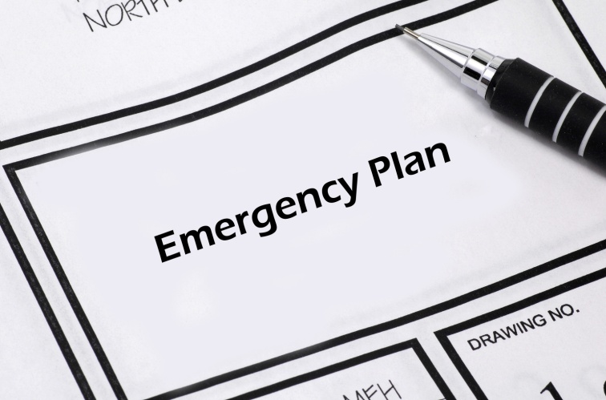
5.5 Revise existing plans and strategies
Changes to the plan will require:
The involvement of stakeholders
Rewriting the plan based on criteria covered in 5.4
Communicating changes to staff
Providing training to support any revisions
Notes:
More information is on page 61 of Trainee Manual. Go through the steps required to change the plan.

Slide 60
5.5 Revise existing plans and strategies
Activity - Revise the existing plan
Notes:
Complete the activity on page 61 of Trainee Manual in the Work Project section for this element.

Slide 61

Thank you!
You’ve completed the “Manage Operational Risk” unit.
Notes:
Thank the students and deliver assessments as required.

